Slide 1
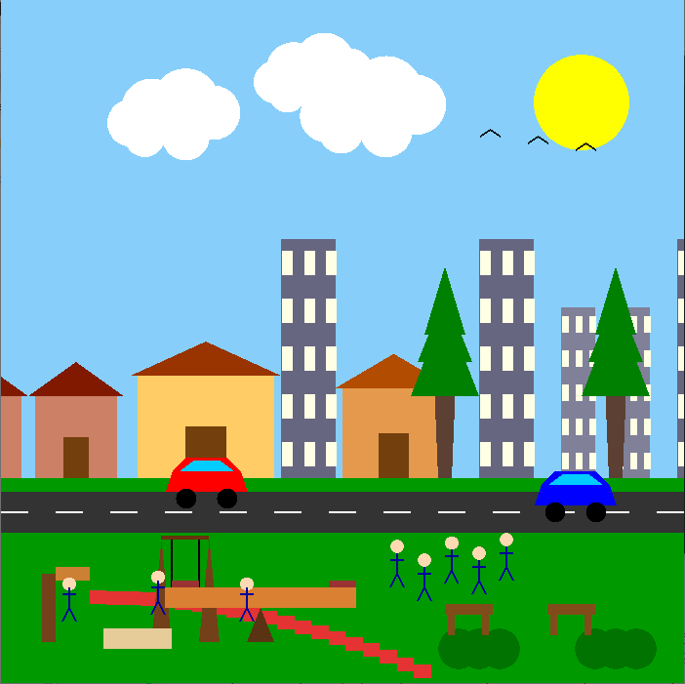
Interactive 2D Scene: Urban
Life day and night simulation
“Urban life with Playground" project. This OpenGL application showcases a dynamic 2D scene featuring a day-night, animated cars, and interactive components.

Slide 2
Introduce With Our Team
Our Team
Md. Mefazur Rahman (0432310005101035)
Nazmul Chowdhury (0432310005101044)
Iqbal Mahmud Emon (0432310005101045)
Md. Shoyaif Rahman (0432310005101050)

Slide 3




Key Scene Elements: Static Objects
Houses
Modern Buildings
Trees & Bushes
Benches
Various residential structures with distinct colors and roof designs.
Tall, multi-windowed structures representing an urban skyline.
Essential natural elements, adding greenery and depth to the landscape.
Park seating, strategically placed for scene detailing.

Slide 4

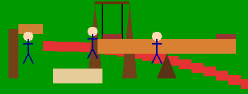
Key Scene Elements: Static Objects
Seesaw
Sun
Kids are playing with the see saw
Sun is in the sky

Slide 5




Animated Objects & Interaction
Clouds
Birds
Slowly drift across the sky, creating a sense of natural movement.
Small birds fly across the upper sky, adding life to the scene.
Cars
Two sports cars move along the road, simulating traffic flow.

Slide 6
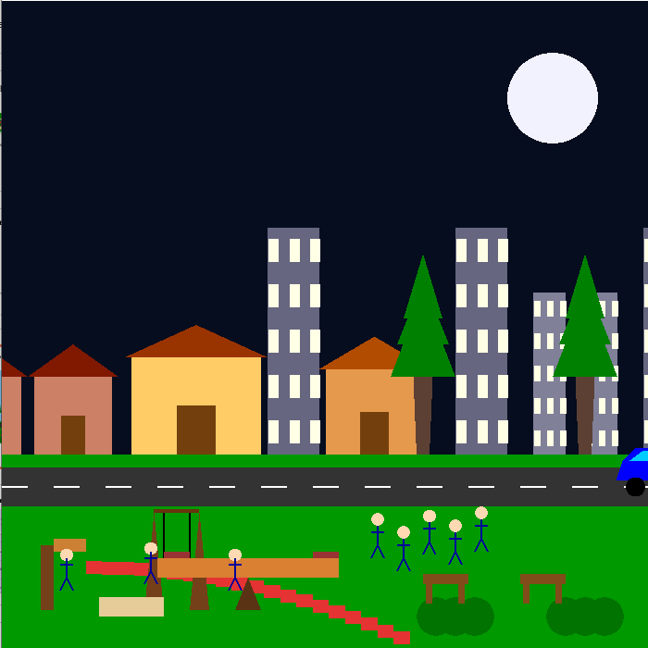
The Day-Night Cycle
Daytime
Night-time

Slide 7
Core OpenGL Functions Used
glutInit
glClearColor
Initializes the GLUT library, essential for window and event management.
Sets the background color, allowing dynamic sky changes for day/night.
glMatrixMode
glOrtho
Specifies the current matrix, typically GL_PROJECTION for setting up the viewing volume.
Defines a 2D orthographic projection matrix, mapping world coordinates to screen space.
glBegin/glEnd
glVertex2f
Delimits the vertices of a primitive, like GL_QUADS for rectangles or GL_POLYGON for complex shapes.
Specifies a vertex in 2D space, defining the points of all drawn objects.
glColor3f
glutDisplayFunc
Sets the current drawing color using RGB float values, applied to subsequent primitives.
Registers the callback function that renders the scene.
glutKeyboardFunc
glutTimerFunc
Registers the callback for keyboard events, used here to toggle day/night.
Schedules a timer callback for animation updates, ensuring smooth motion.

Slide 8
Challenges we face
Smooth animation of cars, pedestrians, birds, and clouds.
Managing object positions, speeds, and interactions.
Designing visually appealing day/night scenes.
Ensuring performance and proper rendering.

Slide 9
Future Enhancements
More Complex Interactions: pedestrians crossing the road.
More Complex Interactions: Implement car braking for pedestrians.
Sound Effects: Add ambient sounds for cars, birds, and playground activities.
Advanced Lighting: Introduce directional lighting for more realistic day/night transitions.
User-Controlled Camera: Allow zooming and panning for different perspectives.

